Slide 1
Monthly Update on 2018-2019 WRAP Workplan March 25th, 2020 TSC and Work Group Co-Chairs Call
Tribal Data WG
Fire and Smoke WG
Oil and Gas WG
Regional Technical Operations WG
Regional Haze Planning WG

Slide 2
Tribal Data Work Group
Status of Letter - Tom

Slide 3
Fire and Smoke Work Group

Slide 4
Workplan Progress by Fire and Smoke Work Group
Workplan Progress over the Last Month
No workgroup calls since last TSC meeting
FFS EI:
Workgroup members sending Matt comments on draft final report on fire emissions inventory work for Regional Haze modeling.
Matt sent Future Fire Scenario Wildfire and Rx EI data to Ramboll.
FETS transition action plan:
Received feedback from Nez Perce Tribe (thank you, Julie!)

Slide 5
Workplan Progress by Fire and Smoke Work Group
Workplan Tasks for the Next Month
Members to review draft EI report and send Matt feedback
Matt will revise FETS Action Plan to include new plan to incorporate with IDW
Draft a list of bullet points to summarize self assessment and outline the future of the workgroup
Final workgroup call will be on April 6.

Slide 6
Proposed Future Projects (same as last month)
Continuing quarterly calls for Fire and Smoke WG (draft bullets)
Provide a venue for federal, state, and tribal fire and smoke people to discuss matters relevant across agencies
Wildfire and Rx coordination across agencies and jurisdictions
Documentation and data sharing for exceptional events due to wildfire or Rx burns
Maintain a link between regional haze planning and operational fire and smoke people
Emissions inventory approaches, remote sensing, and other technical issues involving air quality and fire and smoke

Slide 7
Oil and Gas Work Group

Slide 8
Workplan Progress by Oil and Gas Work Group
Workplan Progress over the Last Month
OGWG review and feedback
Final Revisions (CO & NM information changes): Task 2 – Forecast Scenario (OTB & OTW - Medium Emissions Scenario)
Final Revisions (CO & NM information changes): Task 2 – Forecast Scenarios (OTB & OTW - Low and High Emissions Scenarios)
TSC Docket: Task 4 - Agency Program Review
Consensus Approval: Task 3 – Additional Reasonable Controls
Tasks for the Next Two Months
OGWG Self-Assessment
Coordination - Integration for WRAP OGWG Base and Future Year Emissions Inventories in National Collaborative Platform

Slide 9
Proposed Future Oil and Gas Projects
Potential Additional Future Project/s
OGWG input from members/advisors
Extend period of performance Ramboll contract (e.g., state specific assistance)
Annual compilation of agency program review (i.e., capture regulatory changes)
Potential for contractor specific support needs as identified and funded
Additional discussion planned April 14, 2020 OGWG Bi-Monthly Call
Future OGWG Communication Calls (every 4 months)
Track oil & gas sector and keep up to date via roundtable
Topic specific updates (e.g., BLM analyses using WRAP/OGWG work products)
Identify additional WRAP assistance

Slide 10
Regional Technical Operations Work Group

Slide 11
Workplan Progress by RTOWG Work Group
Workplan Progress over the Last Month
Weekly co-chair coordination calls
Weekly calls with Ramboll to keep track of modeling progress
RTOWG call on 3/12
Weighted Emissions Potential / Area of Influence (WEP/AOI) (discussed later)
Review of white paper for future visibility projections (discussed later)
Comments on model run specification sheets
Roundtable discussion on future modeling exercises
Continued transfer of modeling files to CIRA

Slide 12
Workplan Progress by RTOWG Work Group
Workplan Tasks for the Next Two Months
Future year (2028) CAMx simulations (see table)
Future year (2028) CAMx source apportionment simulation
Continue development of evaluation tools for emissions and model results
Calculate and display 2028 Reasonable Progress Goals (RPG)
Dynamic Model Evaluation

Slide 13
RTOWG Remaining Workplan Tasks

Slide 14
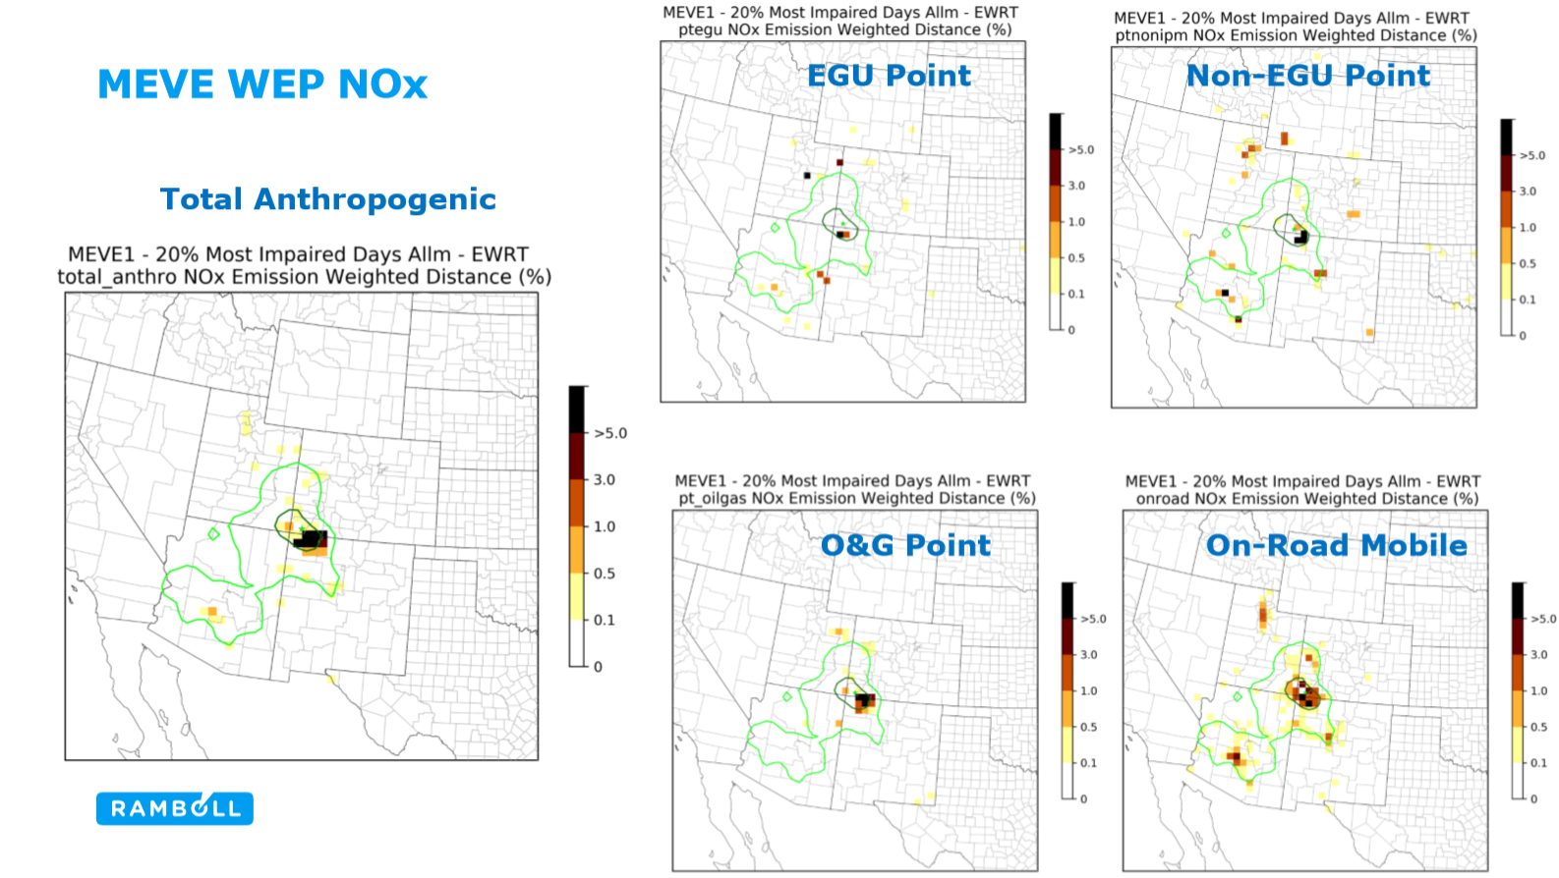
Finished Products: AOI/WEP Analysis

Slide 15
Finished Products: Potential Procedures for Making 2028 Visibility Projections using the WRAP 2014 Modeling Platform

Slide 16
Regional Haze Planning Work Group

Slide 17
Workplan Progress by Regional Haze Planning Work Group
Workplan Progress over the Last Month
No Large Work Group call in February/March
Workplan Tasks for the Next Two Months
Additional opportunity for refinement and state input by 7/1/2020 for another modeling run

Slide 18
Workplan Coordination Activities by Regional Haze Planning Work Group
Workplan Coordination Occurring over the Last Month
March 16th 2028PAC milestone
Workplan Coordination Needed over the Next Two Months
Group meeting scheduled for April 7th
RTOWG modeling update
2028PAC summary by state and additional run
Status update on May 19-20th meeting
Mobile emissions project complete
WRAP State RH Progress Website

Slide 19
Workplan Progress by RH Planning Work Group – Control Measures Subcommittee
Workplan Progress over the Last Month
February call discussion on providing emission reduction estimates to WRAP by March 16th deadline
A few states (AZ, ND & NM) further along in the 4-factor review intend to provide emission reduction estimates for the 2028 control run
Several states (CO, ID, MT, OR, UT, WA) further behind in the 4-factor review will likely rely on OTB/OTW reductions in the 2028 baseline
Couple states (CA & NV) may provide emission reduction estimates
Workplan Tasks for the Next Two Months
Next call on March 23rd
States to continue 4-factor review work
States to review WEP analysis when it becomes available

Slide 20
Workplan Coordination Activities by RH Planning Work Group – Control Measures Subcommittee
Workplan Coordination Occurring over the Last Month
none
Workplan Coordination Needed over the Next Two Months
OGWG call participation

Slide 21
Workplan Progress by Coordination and Glide Path Subcommittee
Workplan Progress for March
TSS FAQ Document Finalized
TSSv2 Delivery Update, Emission Tools, and WEP Presentation
ARS Data Substitution and IMRPOVE December Patch Presentation
Discussion on Interstate Transport Coordination
Workplan Tasks for the Next Two Month
Continue oversight of TSSv2 development
Gain consensus on TSS Glossary
Support creation of RH Storyboard
Testing of TSS tools

Slide 22
Workplan Coordination Activities by Coordination and Glide Path Subcommittee
Workplan Coordination Occurring over the Last Month
Coordination with CIRA
Coordination with ARS
Workplan Coordination Needed over the Next Two Months
Continued engagement with CIRA and ARS

Slide 23
Workplan Progress by RHPWG EI&MP SC
Workplan Progress over the Last Month
Compiled potential additional controls emissions inputs from states
Shared info with states/locals about specs and progress on modeling
Workplan Tasks for the Next Two Months
Reports on results of base & future year visibility, source apportionment modeling, and model performance evaluation
RTOWG contractor-supported report on Reasonable Progress Goals
RTOWG – contractor supported Weighted Emissions Potential (WEP) analysis that will provide WEP maps of source areas impacting each Class I area

Slide 24
Workplan Coordination by RHPWG EI&MP SC
Workplan Coordination Occurring over the Last Month
Coordinated with other states/agencies as needed to review/format potential additional controls emissions files.
Workplan Coordination Needed over the Next Two Months
Coordinate with contractor to receive details and timeline of modeling progress and deliverables.
Coordinate with contractor to transfer potential additional controls emissions files from states.

Slide 25
Proposed Future Projects
Potential Additional Future Project
Secondary additional controls simulation for 2028 Regional Haze period.
Summer 2020 modeling work.
Chance for states to get potential controls from 4-factor analysis into the WRAP RH modeling framework.

Slide 26
End of Workplan Progress Update

